Slide 1
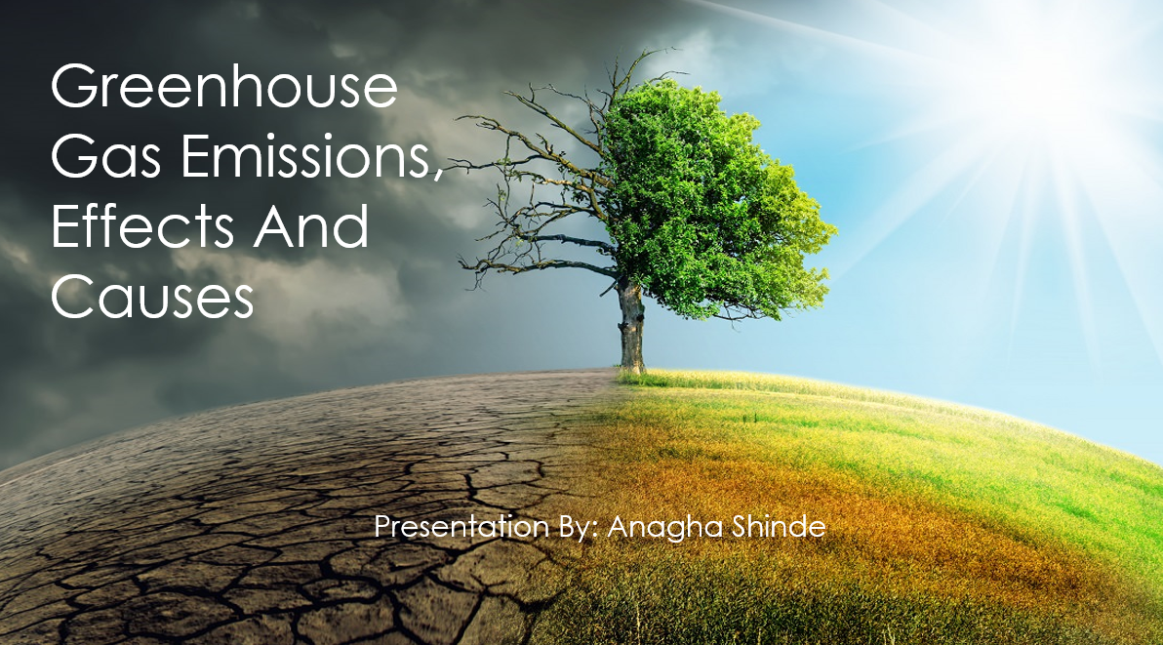

Slide 2

My Motivation Behind This Topic
The motivation behind this topic comes from how soil health has depleted.
Despite right food choices we still rely on supplements.
What’s causing agriculture practices to use chemicals?
How global warming & climate change has impacted agriculture, food industry and overall health of living beings as well as planet.

Slide 3

Objective of this Capstone topic
To gather comprehensive scientific data about the greenhouse gases and its causes.
The rise of green house gases has caused climate change. The changing climate has impacted ecosystem, and it may create imbalance in plant and animal lives.
Extreme weather events like floods, droughts, and heatwaves linked to climate change can directly threaten human health and wellbeing.
Climate change can cause significant economic damage through disruptions to agriculture, infrastructure, and coastal communities.
Understanding greenhouse gases enables informed decision-making about reducing emissions and developing sustainable practices to combat climate change.

Slide 4
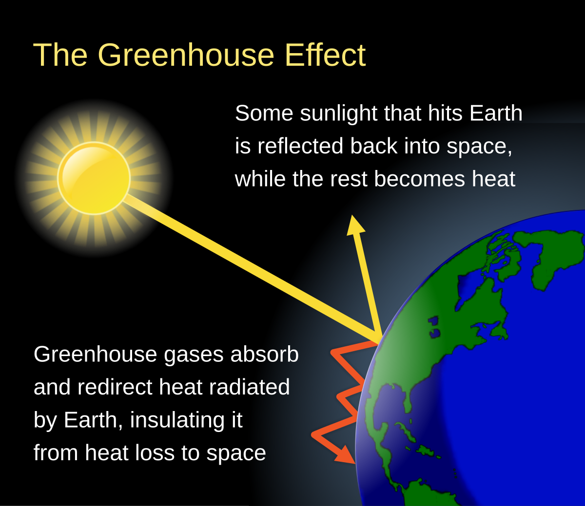
What is Greenhouse Gas Effect?
The atmosphere’s ability to trap thermal energy or heat is called the greenhouse effect.
The greenhouse effect is an essential process that keeps our planet temperate and habitable.
But human activities produce additional thermal energy and emit greenhouse gases into the atmosphere—increasing the amount of heat being trapped which gives rise to global warming.

Slide 5
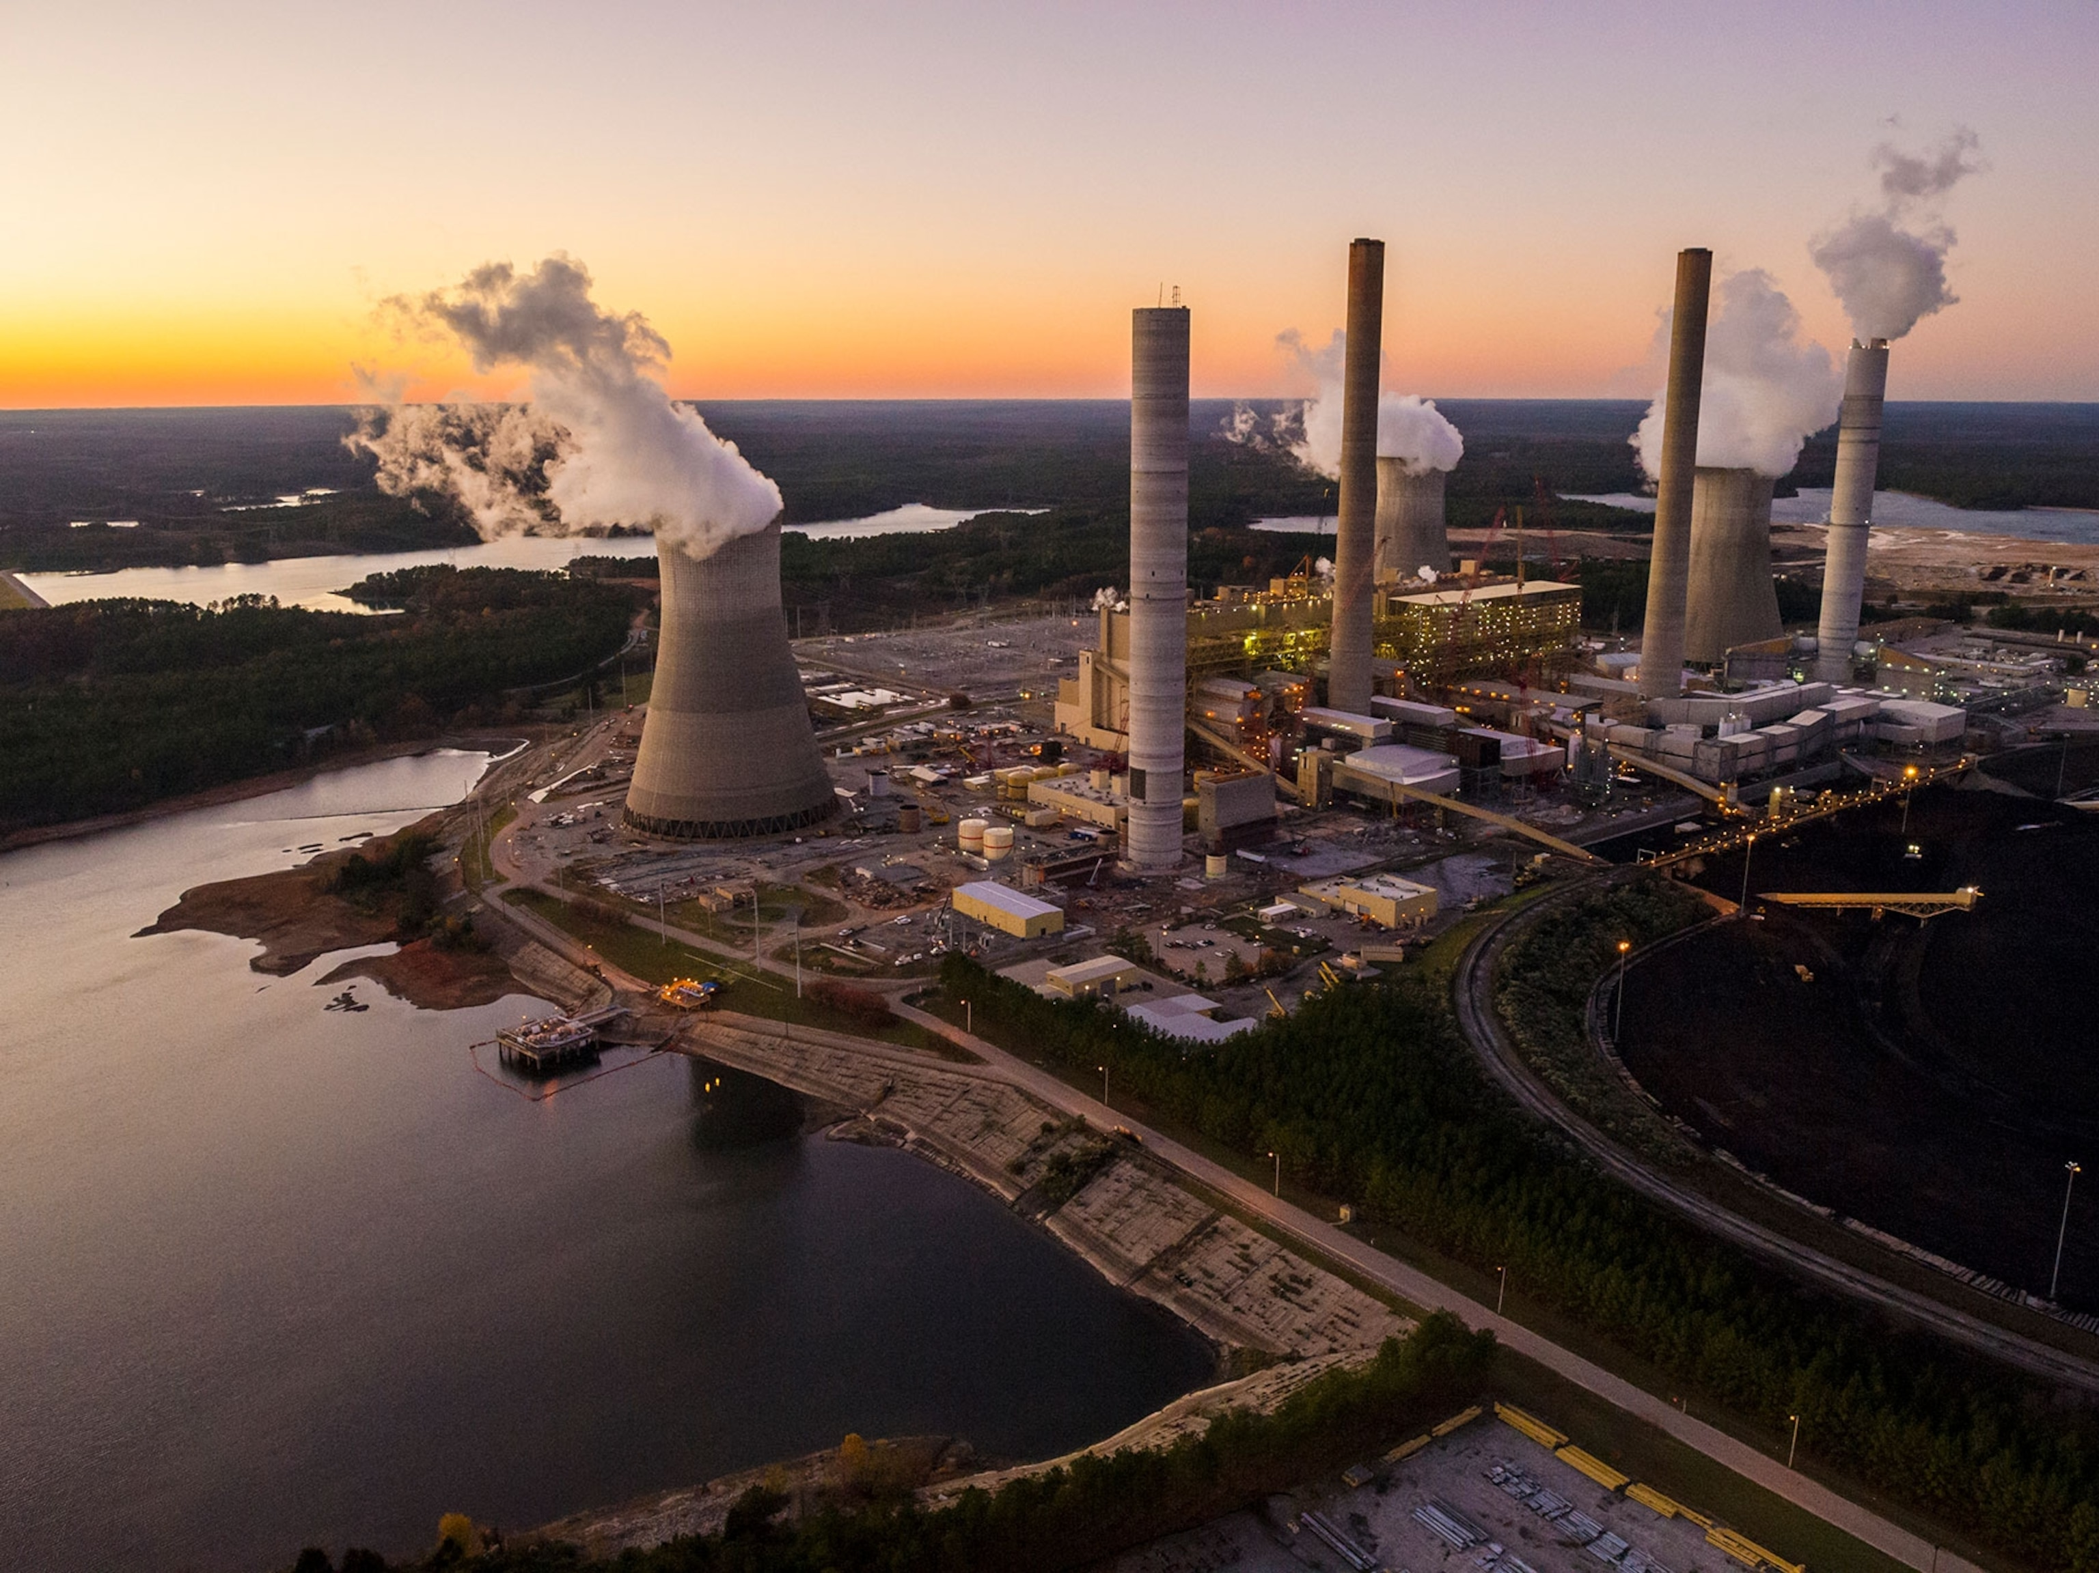
Human Activities & Greenhouse Effect
Human activities are responsible for almost all the increase in greenhouse gases in the atmosphere over the last 150 years.
The largest source of greenhouse gas emissions from human activities in the United States is from burning fossil fuels for electricity, heat, and transportation.

Slide 6

What Are Green House Gases?

Slide 7
The Greenhouse Gases
CO2
CH4
N2O
Fluorinated
Gases
Water vapor H2O
Ozone
CH4

Slide 8

How long do they stay in atmosphere?
Carbon Dioxide
Methane
Nitrous oxide
= Thousands of years
= Up to one decade
= More than 100 years

Slide 9
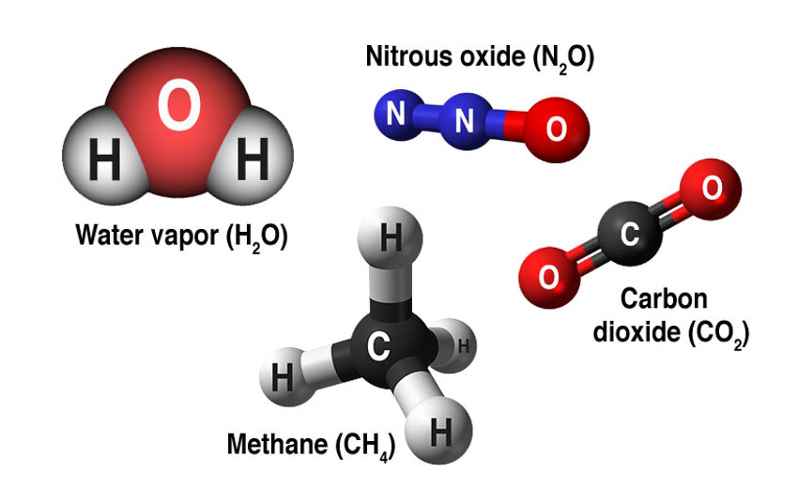
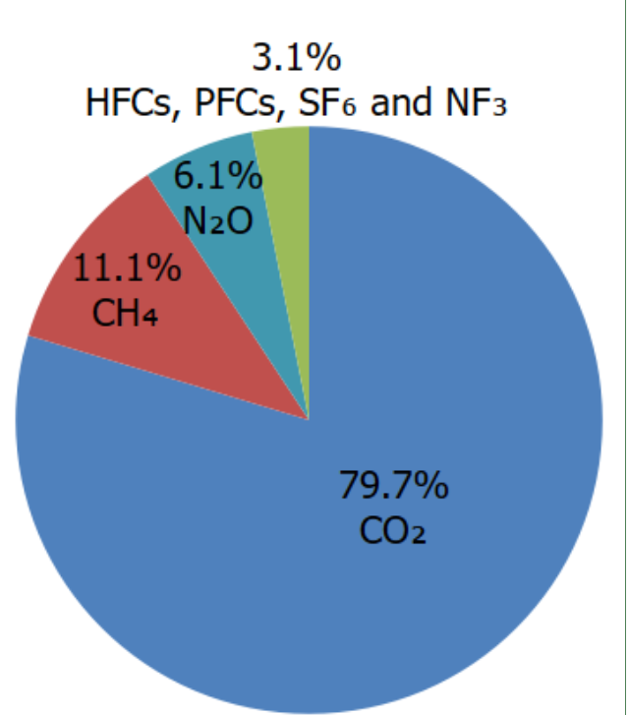
Which Greenhouse gas is a dominant contributor?

Slide 10
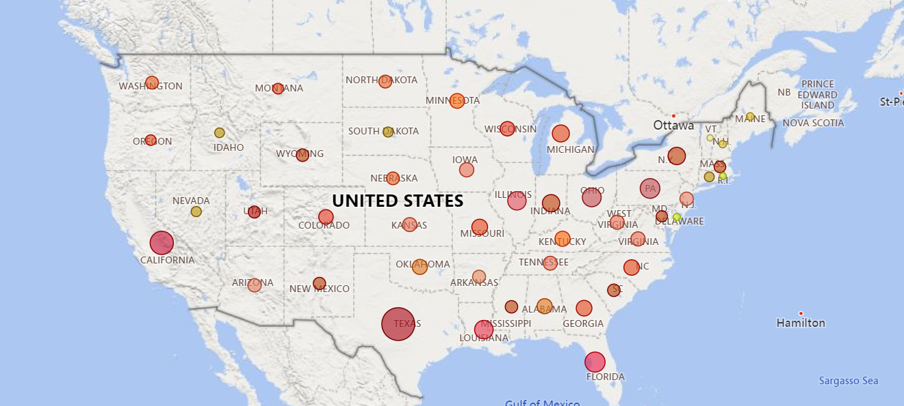
Greenhouse Gas Emission By State

Slide 11
Sources of Greenhouse Gases
Commercisl & Residential
Transportation
Agriculture
Electricity Production
Land Use & Forestry
Industrty

Slide 12
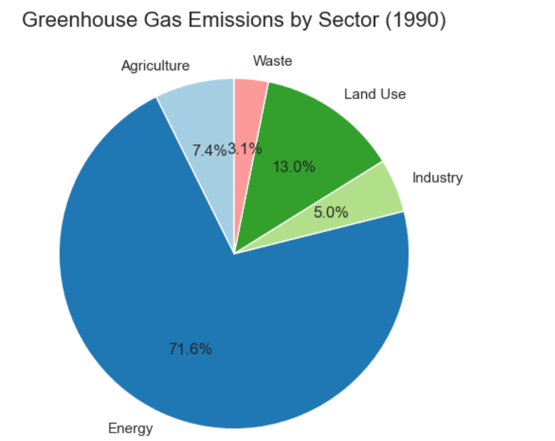
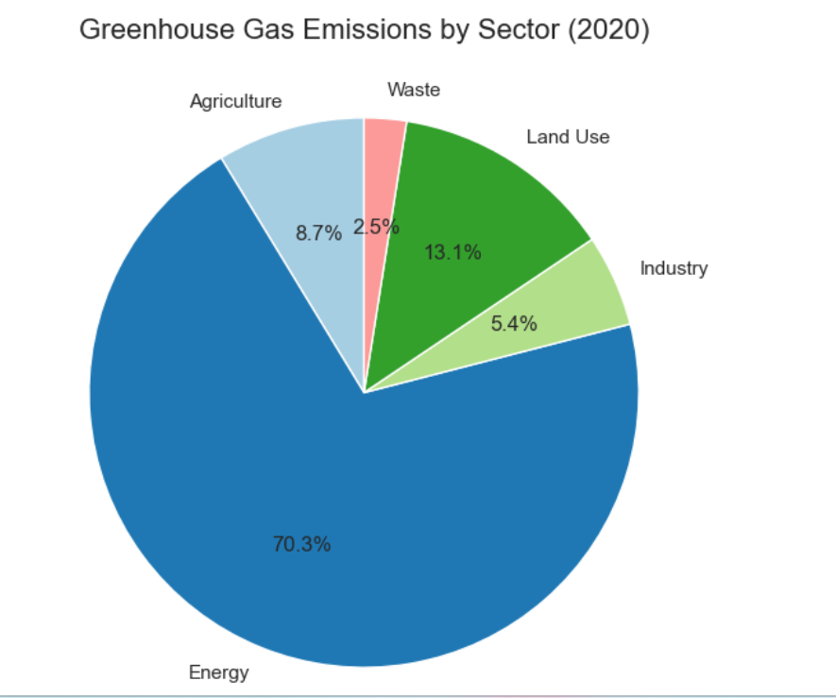
Greenhouse gas emission by sectors

Slide 13
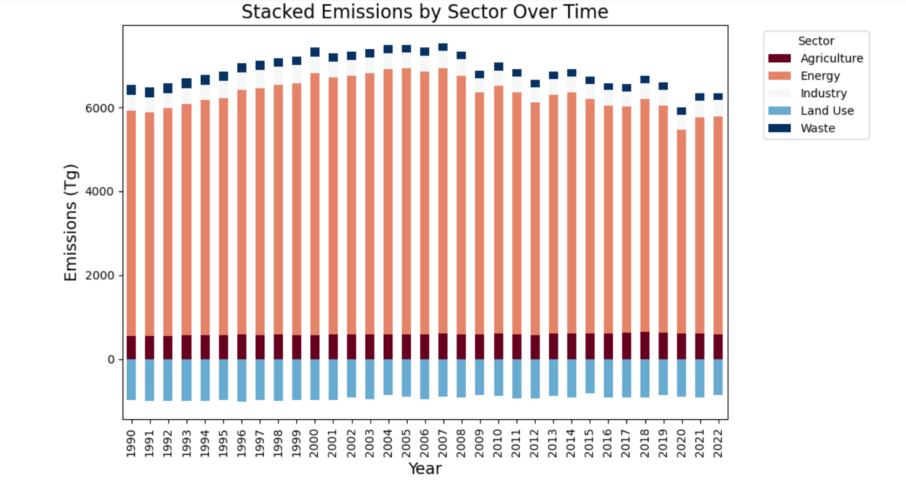
*Tg stands for teragrams of carbon dioxide equivalent. 1Tg=1012gms

Slide 14


Slide 15
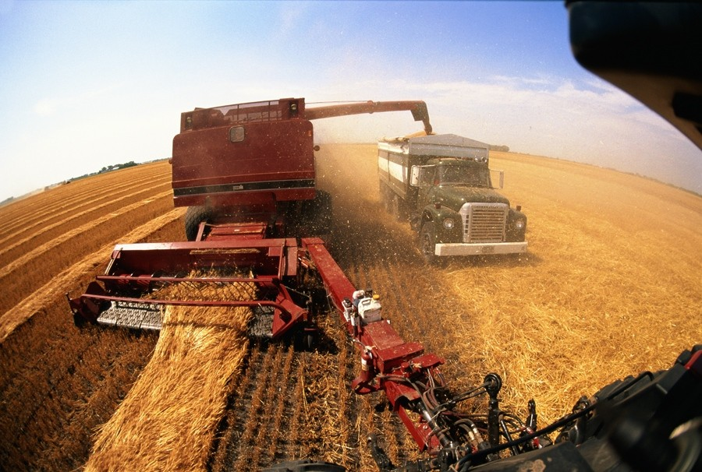
Agricultural Practices & Emission
Management practices: soil nitrification and denitrification, which produces nitrous oxide (N₂O) emissions is very much influence by soil management practices, such as the application of synthetic and organic fertilizers, deposition of livestock manure and the growth of nitrogen-fixing plants.
Biomass burn- burning of crops for harvesting, land for clearance or burning of agricultural residues.
Fossil fuel (non-renewable energy) usage in agricultural equipment.
Rice cultivation is one of the most relevant crops in terms of emission, especially considering its importance as food and therefore the amount produced.

Slide 16
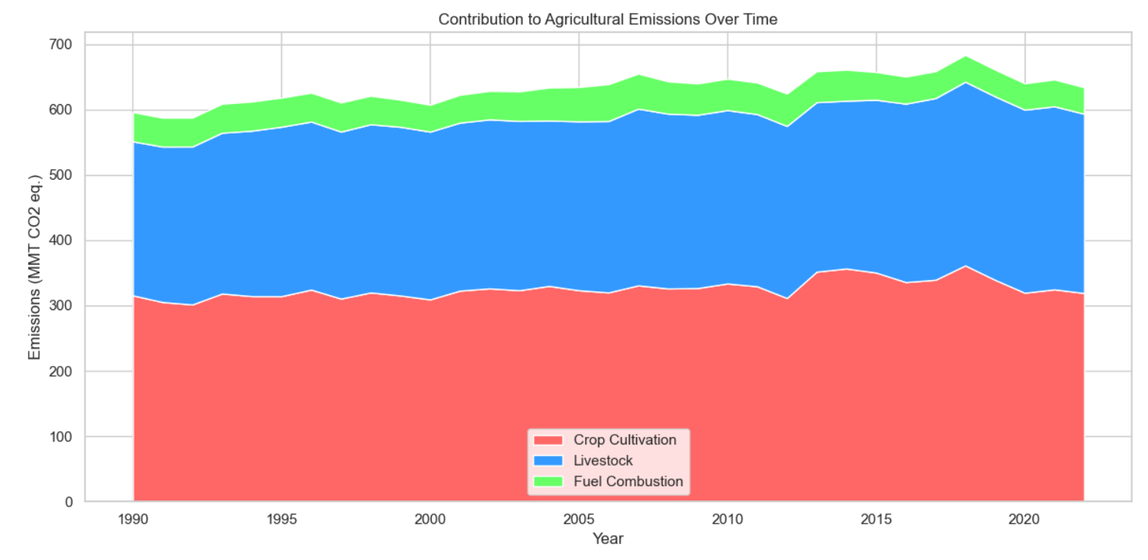
MMT CO2 equivalent stands for "Million Metric Tons of Carbon Dioxide Equivalent.”

Slide 17

Transportation & Energy
The transportation sector is the largest contributor to greenhouse gas (GHG) emissions in the United States, accounting for about 28% of total U.S. GHG emissions in 2022. This is due to the burning of fossil fuels like gasoline and diesel in cars, trucks, ships, boats, and aircraft.
It builds up GHGs like carbon dioxide (CO2), methane (CH4), nitrous oxide (N2O), and hydrofluorocarbons (HFCs) in the atmosphere is causing the Earth's climate to change. To address the climate crisis, the U.S. has a national goal of net-zero GHG emissions by 2050.

Slide 18
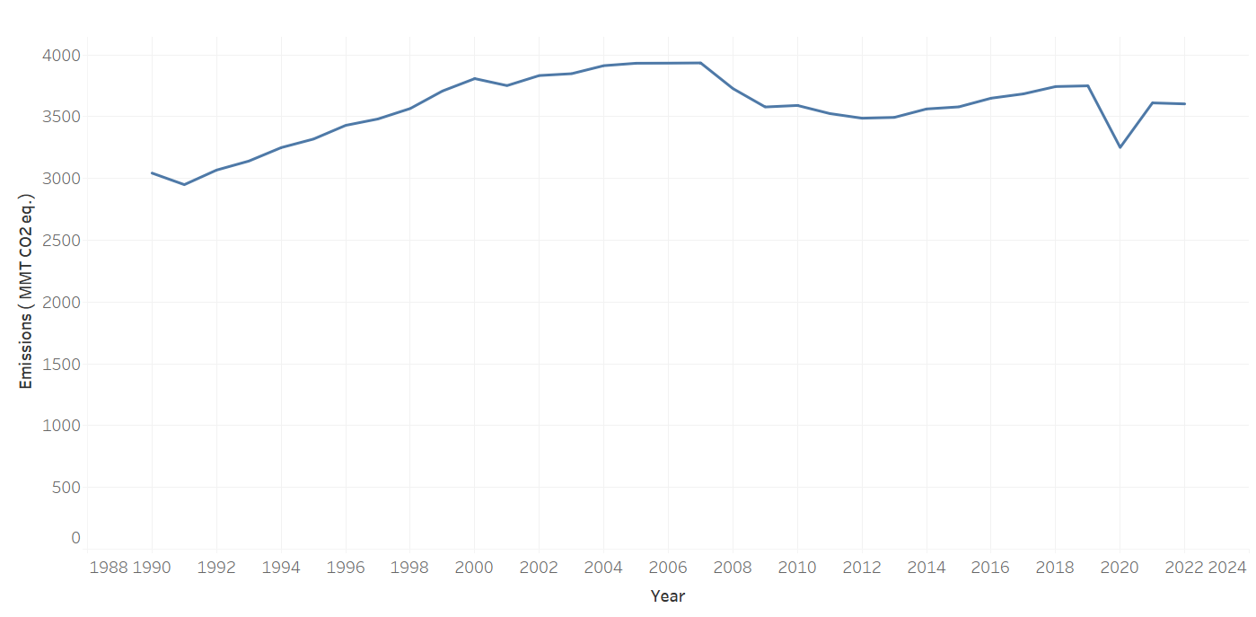
Transportation

Slide 19
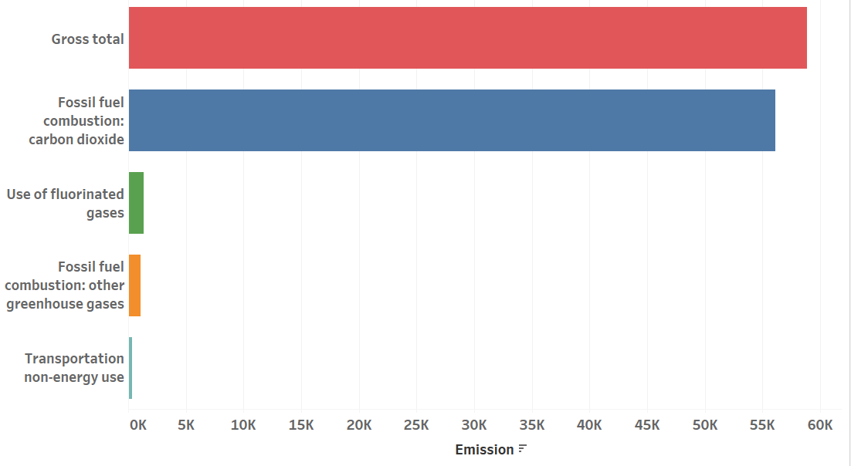
Transportation

Slide 20
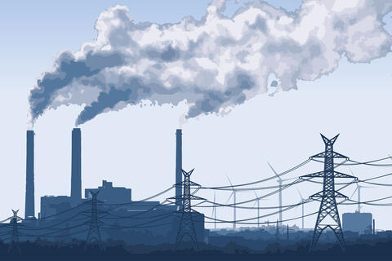
Energy
The electricity generation sector, which largely depends on fossil fuels, is considered one of the biggest contributors to global greenhouse gas emissions.
When fossil fuels are burned to produce energy, the primary greenhouse gas released is carbon dioxide.
Energy production, particularly when relying on fossil fuels like coal, oil, and natural gas, has a significant impact on greenhouse gas emissions, contributing a large portion of carbon dioxide (CO2) and other greenhouse gases to the atmosphere, primarily through the combustion process used to generate electricity and heat, thereby significantly contributing to climate change.

Slide 21
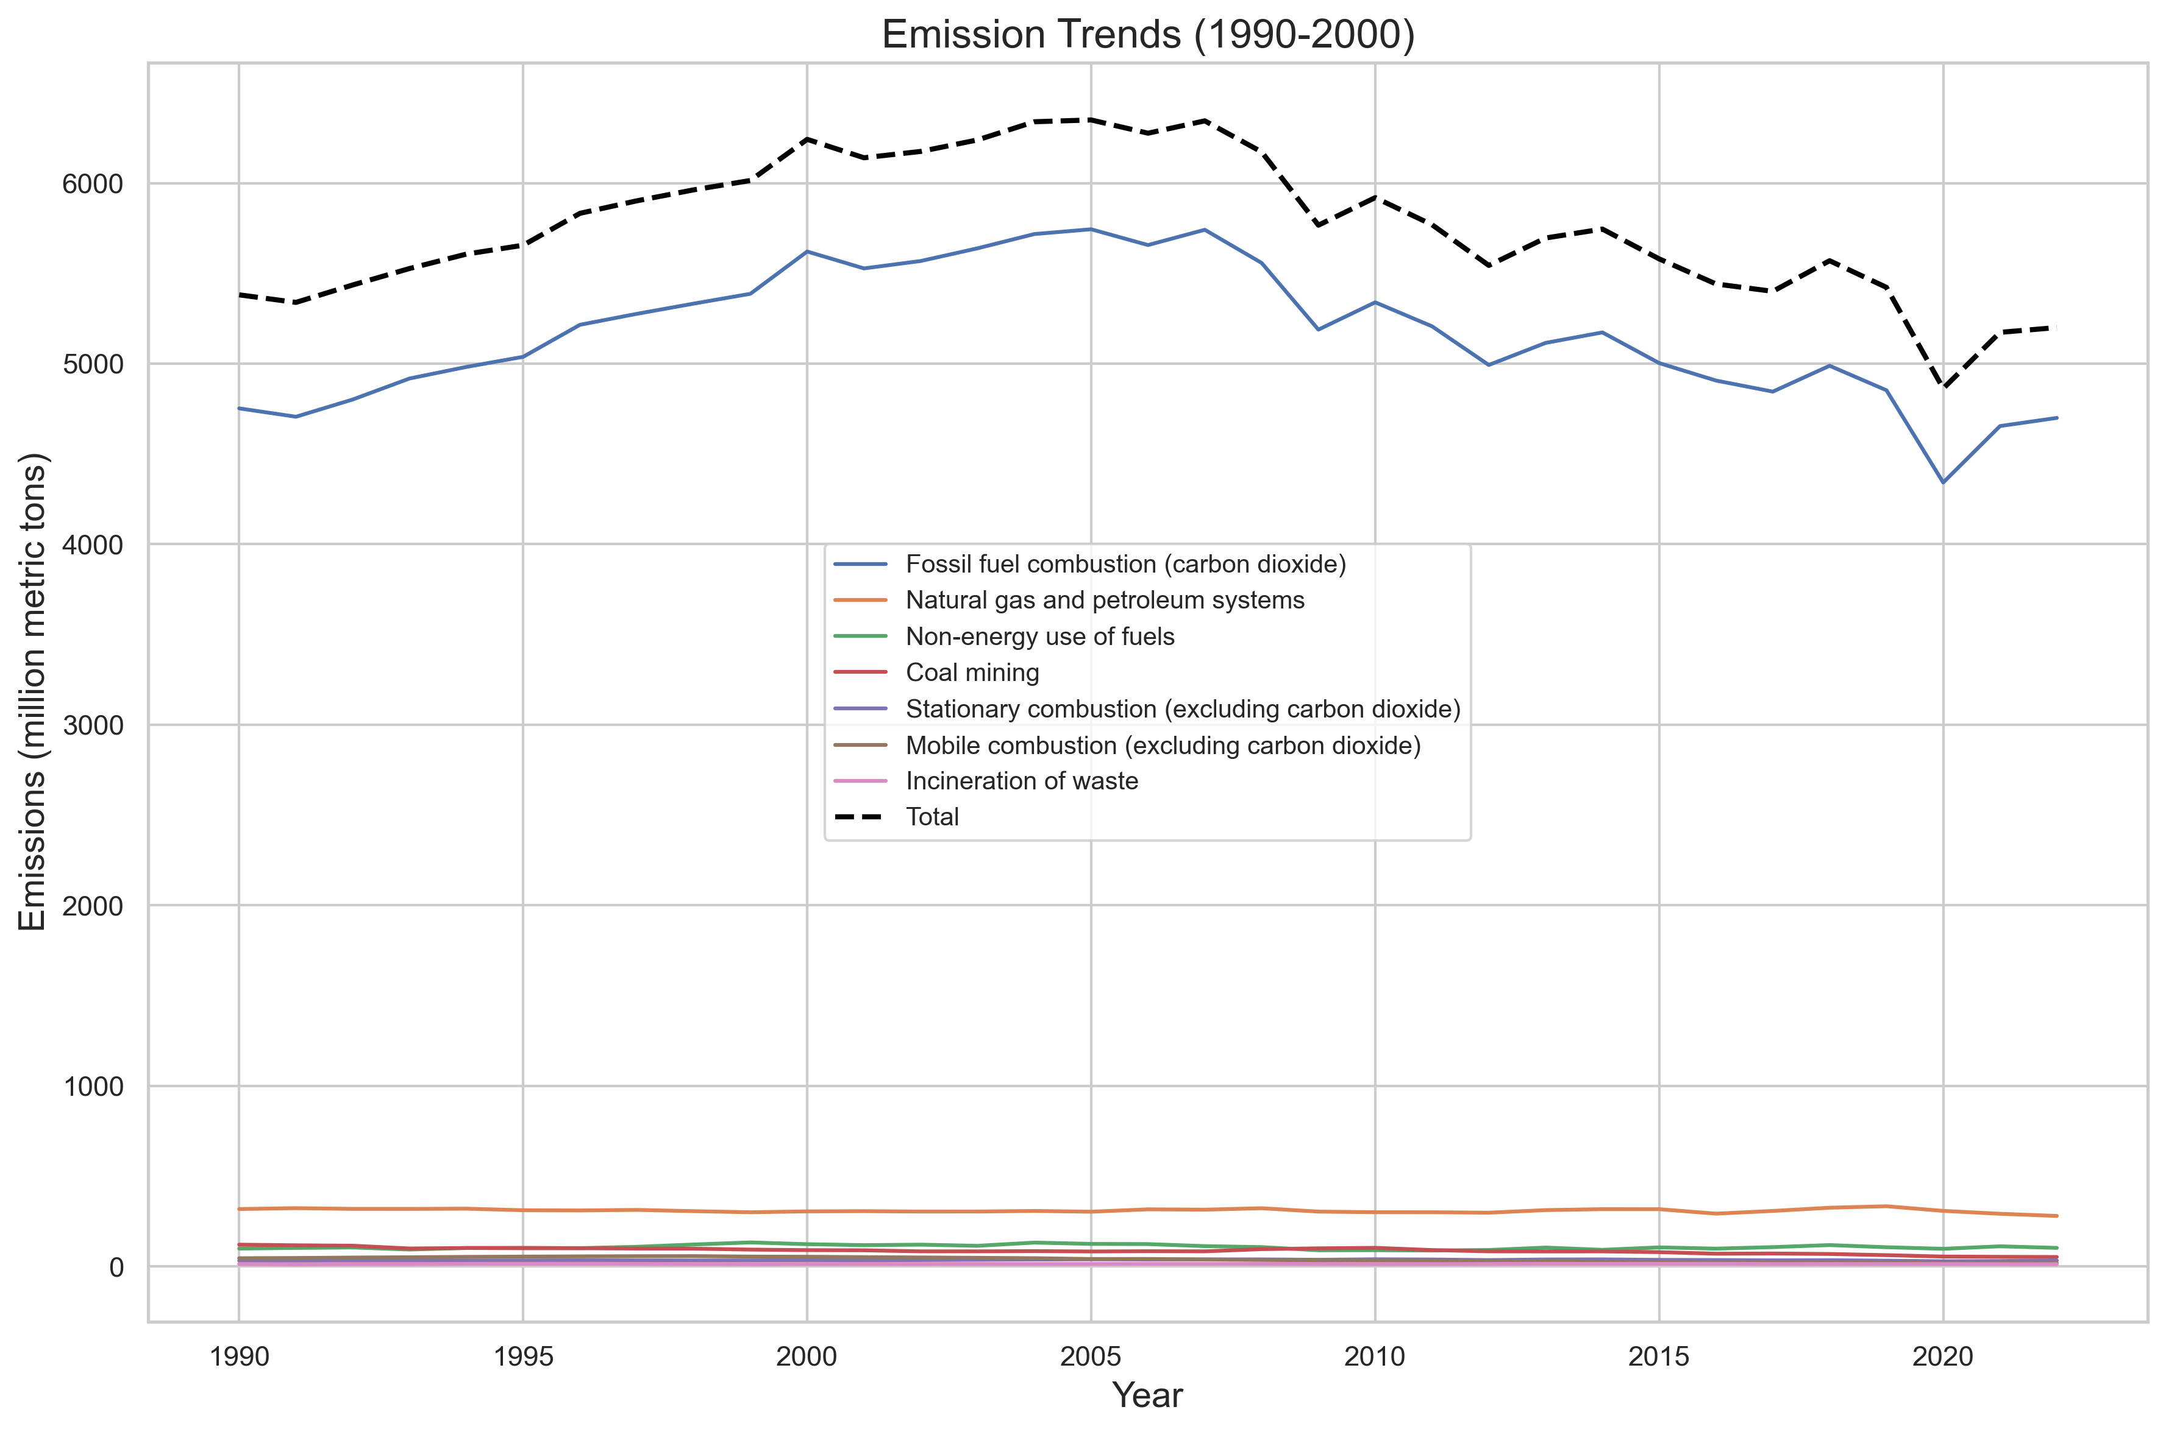

Slide 22

Land Use
In the United States, since 1990, managed forests and other lands are a net sink, i.e., they have absorbed more CO₂ from the atmosphere than they emit, offsetting 13% of total gross greenhouse gas emissions.
In the U.S. land use activities have caused more removal of CO2 from atmosphere than emission.
Greenhouse gas emissions due to land use, primarily comes from activities like deforestation, conversion of forests to farmland, and certain agricultural practices.

Slide 23
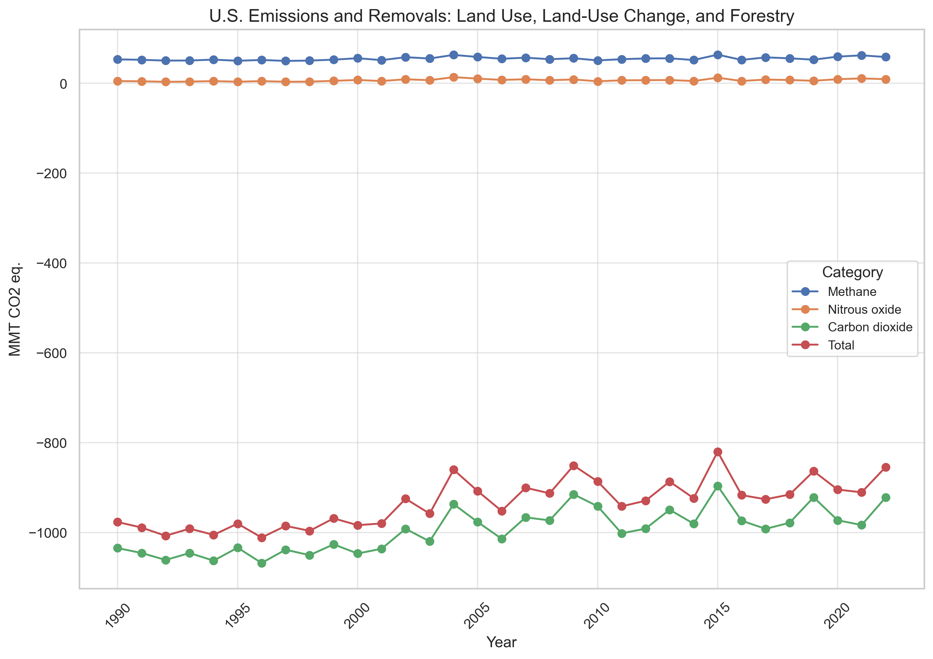
Land Use

Slide 24

Commercial & Residential
Commercial and residential greenhouse gases primarily come from the burning of fossil fuels like natural gas for heating, cooking, and water heating in buildings. Also, emissions from refrigerants used in air conditioning systems, contributing significantly to carbon dioxide (CO2), methane (CH4), and nitrous oxide (N2O) emissions in these sectors.
Essentially, most emissions stem from energy consumption within homes and businesses for daily operations like lighting and appliances.

Slide 25
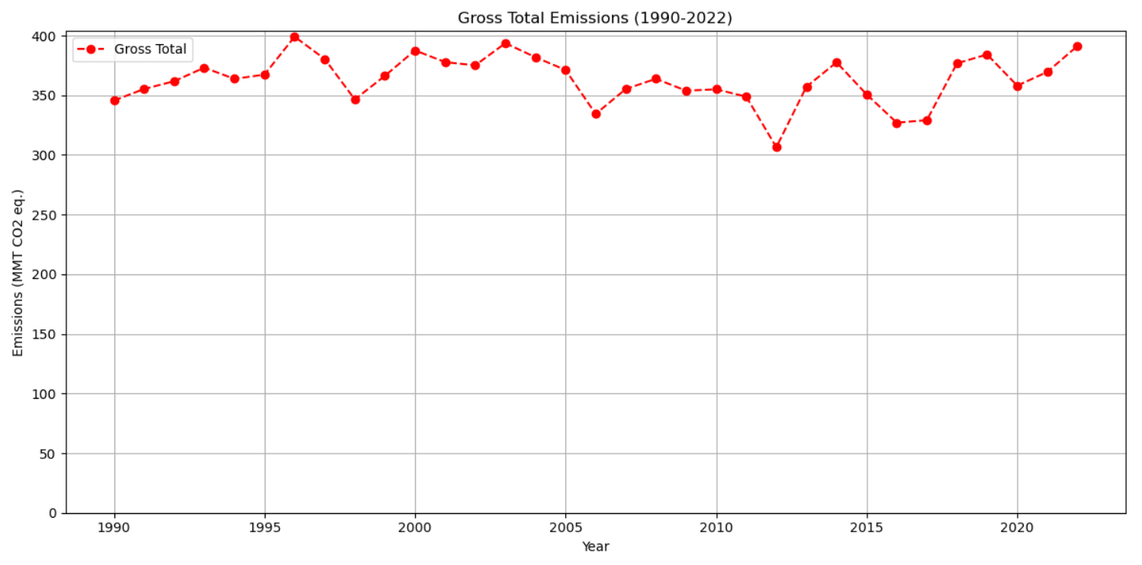
Commercial & Residential Emission

Slide 26
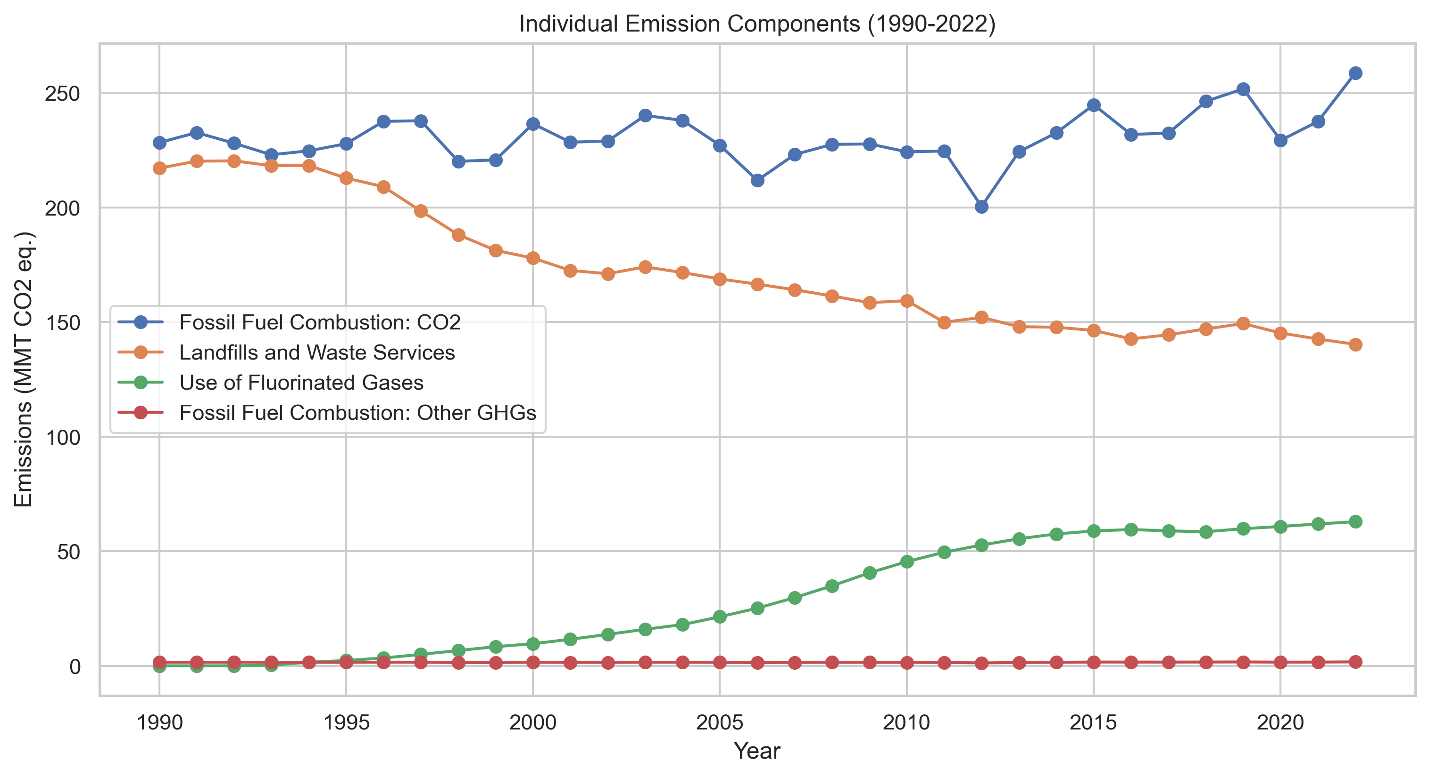
GGE in Residential & Commercial
*GGE stands for greenhouse gas emission. MMT CO2 eq" stands for "Million Metric Tons of Carbon Dioxide Equivalent

Slide 27
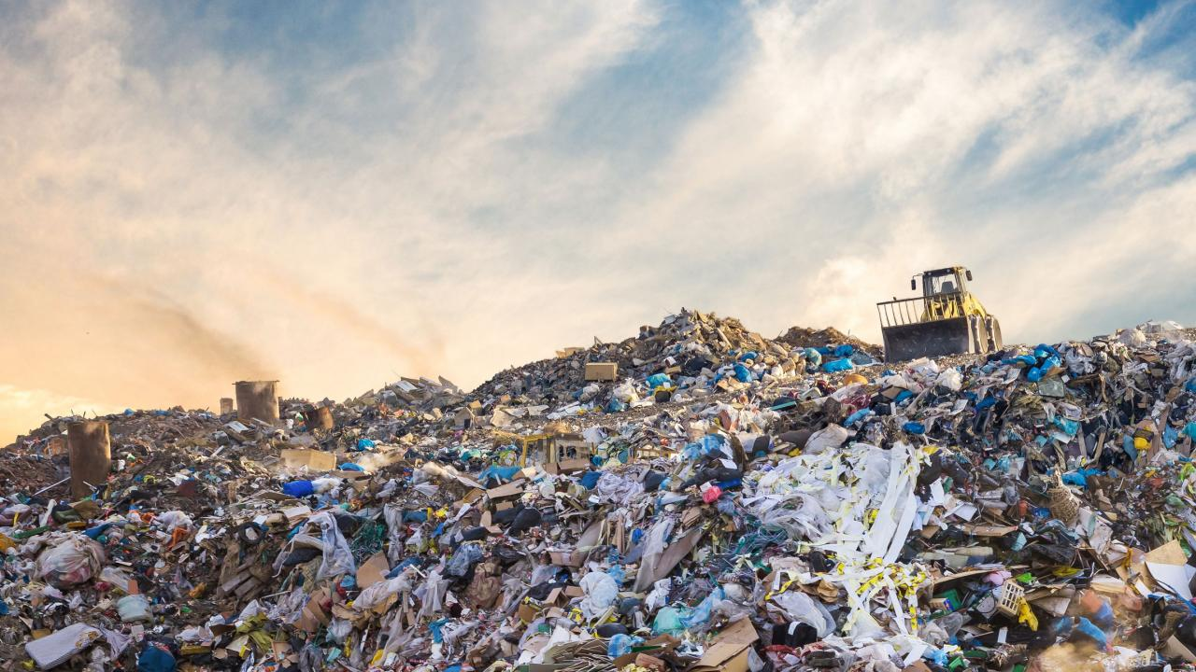
Waste Emission
Waste, particularly organic matter decomposing in landfills, significantly contributes to greenhouse gas emissions.
When organic waste decomposes in landfills under anaerobic conditions, it produces methane, a powerful greenhouse gas responsible for a large portion of waste-related emissions
Food waste is a major contributor to landfill methane emissions due to its quick decay rate.
The waste sector is estimated to contribute around 20% of global methane emissions.

Slide 28
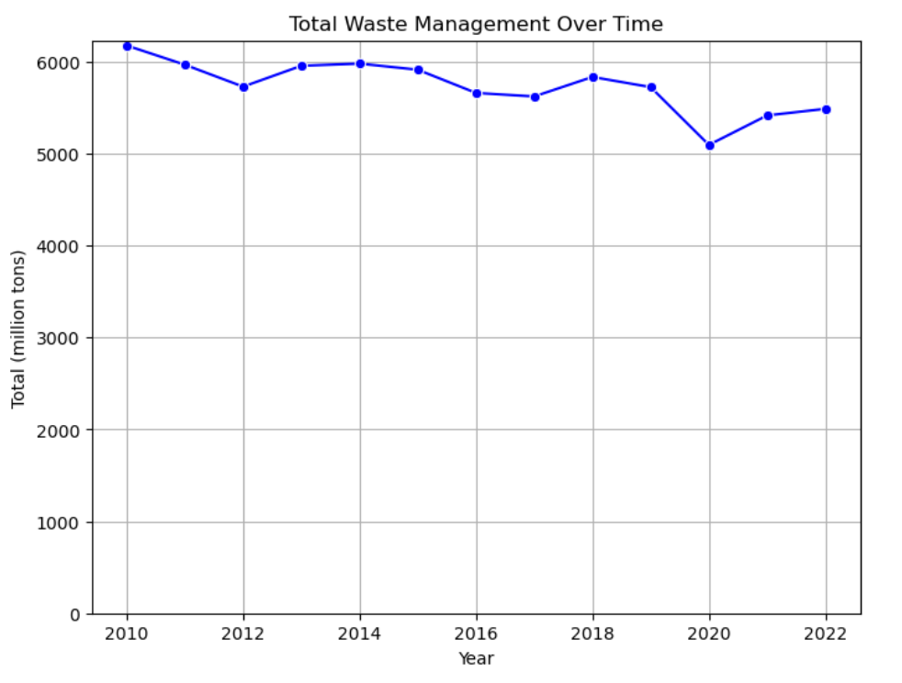
Emission From Waste

Slide 29
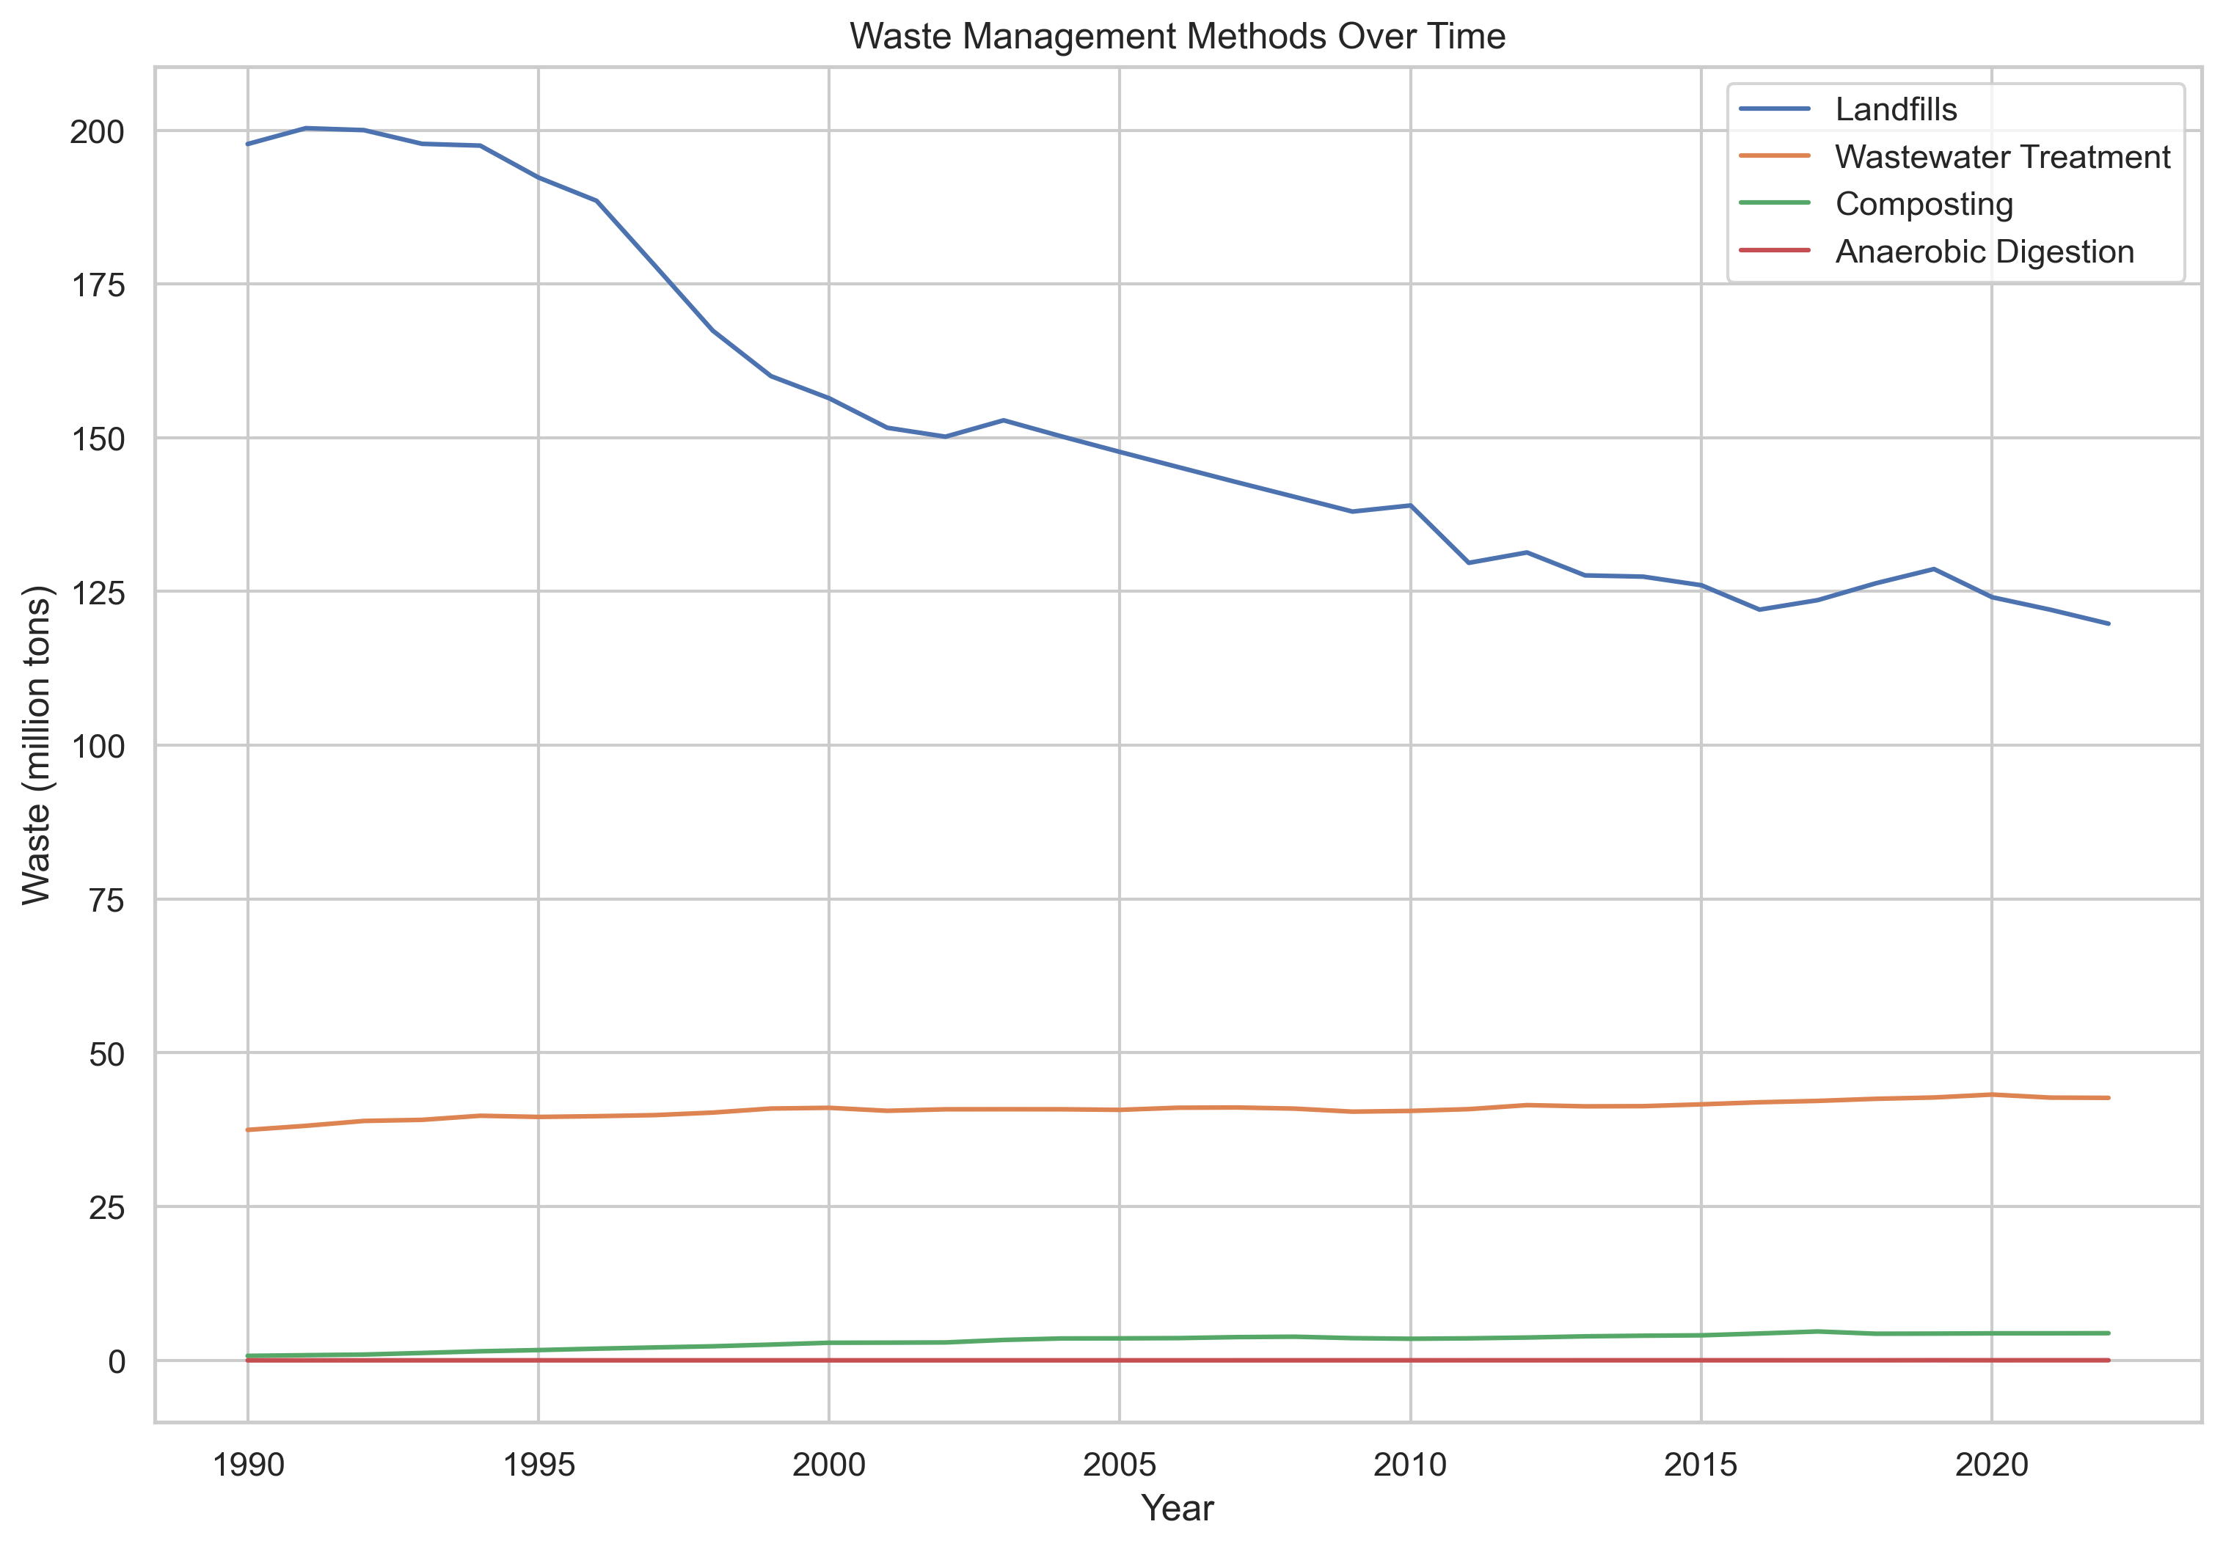
Emission From Waste

Slide 30
Greenhouse Effect During Covid-19
What’s Different in 2020?
2020
1990

Slide 31
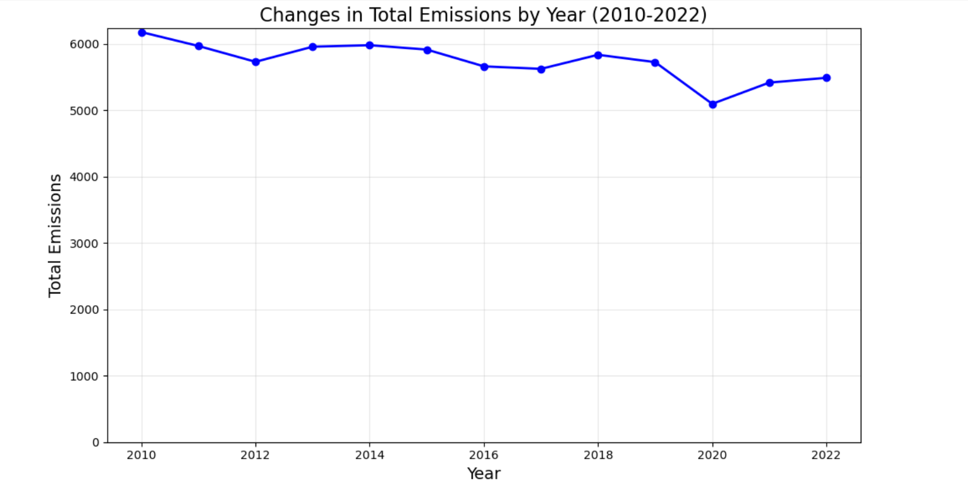
Total emission over decades

Slide 32





Slide 33
Pandemic Impact on GGE
Earth’s atmosphere reacted in surprising ways to the lowering of emissions during the pandemic, showing how closely climate warming and air pollution are linked.
The COVID-19 pandemic and resulting limitations on travel and other economic sectors by countries around the globe drastically decreased air pollution and greenhouse gas emissions within just a few weeks.
The climate warming and air pollution are directly linked.
In year 2020, during the lockdown US greenhouse gas emission also shows significant decline.
The global COVID-19 lockdowns caused fossil CO₂ emissions to decline by an estimated 2.4 billion tones in 2020 - a record drop according to new estimates from researchers at the University of East Anglia (UEA), University of Exeter and the Global Carbon Project, an initiative chaired by Stanford University scientist Rob Jackson.

Slide 34
Highlights
Carbon dioxide (CO2) is the primary greenhouse gas produced by human activities, followed by methane (CH4) and nitrous oxide (N2O).
The energy and transportation sectors are the largest contributors to greenhouse gas emissions.
The pandemic year demonstrated that reduced human activities, particularly in transportation, led to a significant decrease in greenhouse gas emissions and pollution.
The burning of fossil fuels remains the biggest driver of greenhouse gas emissions.

Slide 35
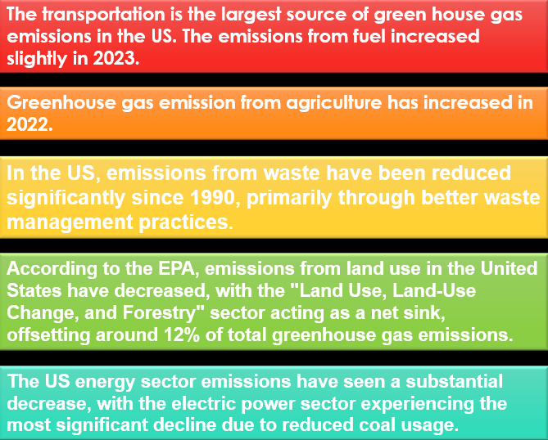

Conclusion

Slide 36

Final Thoughts, Questions & Dashboard
The primary conclusion regarding greenhouse gases is that its causing significant global warming which leads to climate change with potential impacts like rising sea levels, melting glaciers, extreme weather events, and disruptions to ecosystems.
Awareness and conscious living can create a huge impact in saving our planet and implement required policies.

